Slide 1

Cumbria
Health Protection Tactical Oversight Group
Weekly COVID-19 Summary
2021 Week 41 (Ending Friday 15th October)
Summary Produced Wednesday 20th October
Produced By Cumbria Resilience Multi Agency Intelligence Cell (MAIC)

Slide 2
Weekly Summary: Key points
2021 Week 41 (Ending Friday 15th October)
Cases & Demographics
Key Points for Cumbria and districts in 2021 Week 41 (Ending Friday 15th October):
There were 2,702 new cases in Cumbria (a decrease of 296, -10%, from 2,998 new cases in the previous week);
Carlisle overtook Allerdale in having the greatest number of new cases (+540 new cases);
Furthermore, Copeland overtook Barrow-in-Furness in having the highest rate of new cases (720 new cases per 100k population);
Rates in all Cumbrian districts, except Eden, were above the regional and national averages (North West 462 and England 449 new cases per 100k population);
However, new cases decreased from the previous week in all Cumbrian districts, except Copeland;
In Copeland new cases increased by 16%;
The 12-18 age group accounted for the greatest number of new cases in Cumbria followed by the 5-11 age group (+542 and +448 new cases respectively);
The 12-18 and 5-11 age groups also accounted for by far the greatest rates of new cases in Cumbria (1,480 and 1,202 new cases per 100k population respectively);
However, new cases decreased from the previous week in the 12-18 and 5-11 age groups (-25% and -7% respectively);
New cases also decreased from the previous week in all other age groups except the 0-4, 19-24, 25-29 and 80+ age groups;
The 19-24 age group experienced the greatest numerical and proportional increase (an increase of 12, +15%, from the previous week);
New cases in the under 50 age group accounted for 70% of total new cases (compared to 72% in the previous week);
The rate of new cases in the under 50 age group was 2.1 times higher than the rate of new cases in the 50+ age group (compared to 2.3 times higher in the previous week);
Overall, new cases in the under 50 age group decreased by 12% compared to a 4% decrease in the 50+ age group.
Health & Hospitalisations
Summary for week ending Tuesday 19th October:
The number of new patients admitted with COVID-19 Positive status in North Cumbria Integrated Care (NCIC) increased by 16 from the previous week;
Furthermore, the number of new patients admitted with COVID-19 Positive status in University Hospitals of Morecambe Bay NHS Foundation Trust (UHMB) increased by 10 from the previous week;
The average number of patients with COVID-19 in beds in NCIC increased by 6 from the previous week;
However, the average number of patients with COVID-19 in beds in UHMB decreased by 2 from the previous week.
Mortality
In the week to Friday 8th October 2021 there were 6 COVID-19 related death occurrences in Cumbria.

Slide 3
R estimates & Growth Rates
NHS Region
Region | R | Growth rate % per day
England | 0.9 to 1.1 | -1 to +2
East of England | 0.9 to 1.2 | -1 to +3
London | 0.9 to 1.1 | -2 to +2
Midlands | 0.9 to 1.1 | -1 to +2
North East and Yorkshire | 0.9 to 1.1 | -1 to +1
North West | 0.9 to 1.1 | -1 to +2
South East | 0.9 to 1.1 | -1 to +2
South West | 0.9 to 1.1 | -1 to +2
Source: gov.uk. Last updated
15 October 2021.
North Cumbria falls within the North East and Yorkshire region.
The values are shown as a range, the most likely true values are somewhere towards the middle of this range.
* Particular care should be taken when interpreting these estimates as they are based on low numbers of cases, hospitalisations or deaths, and/or dominated by clustered outbreaks. They should not be treated as robust enough to inform policy decisions alone.

Slide 4
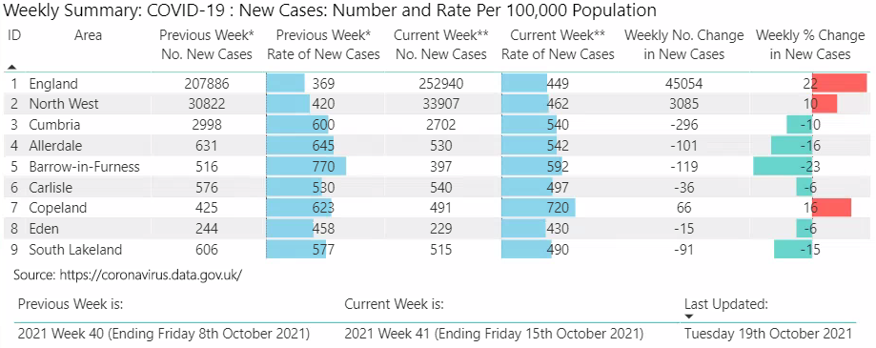
Cases
Key Points for Cumbria and districts in 2021 Week 41 (Ending Friday 15th October):
There were 2,702 new cases in Cumbria (a decrease of 296, -10%, from 2,998 new cases in the previous week);
Carlisle overtook Allerdale in having the greatest number of new cases (+540 new cases);
Furthermore, Copeland overtook Barrow-in-Furness in having the highest rate of new cases (720 new cases per 100k population);
Rates in all Cumbrian districts, except Eden, were above the regional and national averages (North West 462 and England 449 new cases per 100k population);
However, new cases decreased from the previous week in all Cumbrian districts, except Copeland;
In Copeland new cases increased by 16%.
Note: This represents the number of people with a positive test result

Slide 5
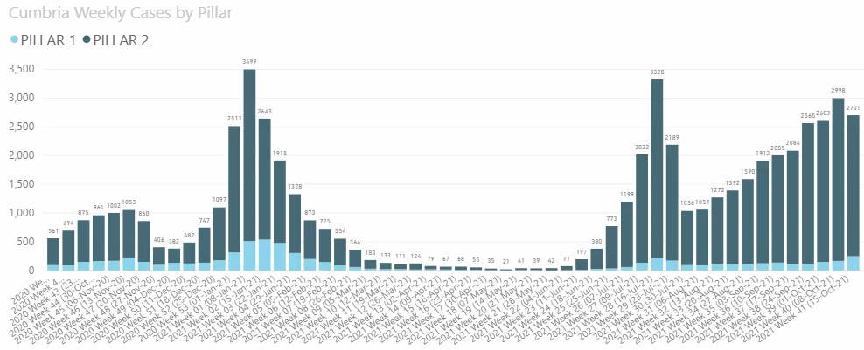
Cumbria Cases
2nd Lockdown:
5th Nov-2nd Dec
3rd Lockdown:
5th Jan-29th Mar
Step 1 Easing:
29th Mar-12th Apr
Step 2 Easing:
12th Apr-
17th May
Step 3 Easing:
17th May-18th Jul
Step 4 Easing:
19th Jul
Source: PHE (data represents the number of people with a positive test result)

Slide 6

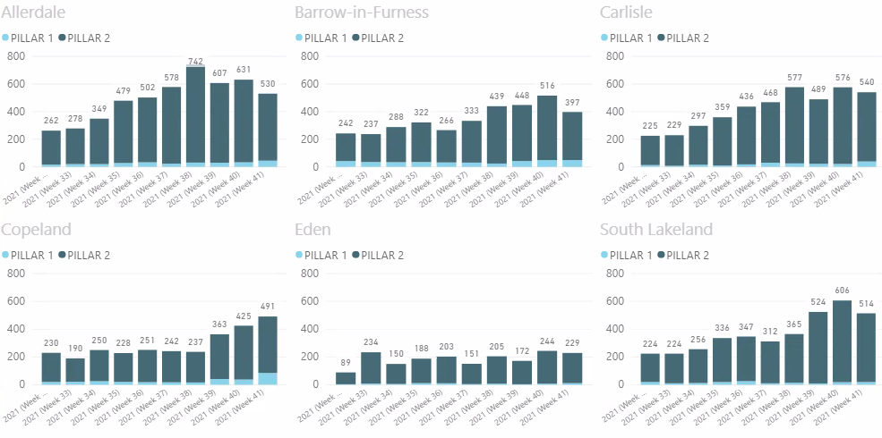
District Cases
Key Points for Cumbria and districts in 2021 Week 41 (Ending Friday 15th October):
Carlisle overtook Allerdale in having the greatest number of new cases (+540 new cases);
Furthermore, Copeland overtook Barrow-in-Furness in having the highest rate of new cases (720 new cases per 100k population);
New cases decreased from the previous week in all Cumbrian districts, except Copeland;
In Copeland new cases increased by 16%.
Source: PHE (data represents the number of people with a positive test result)

Slide 7
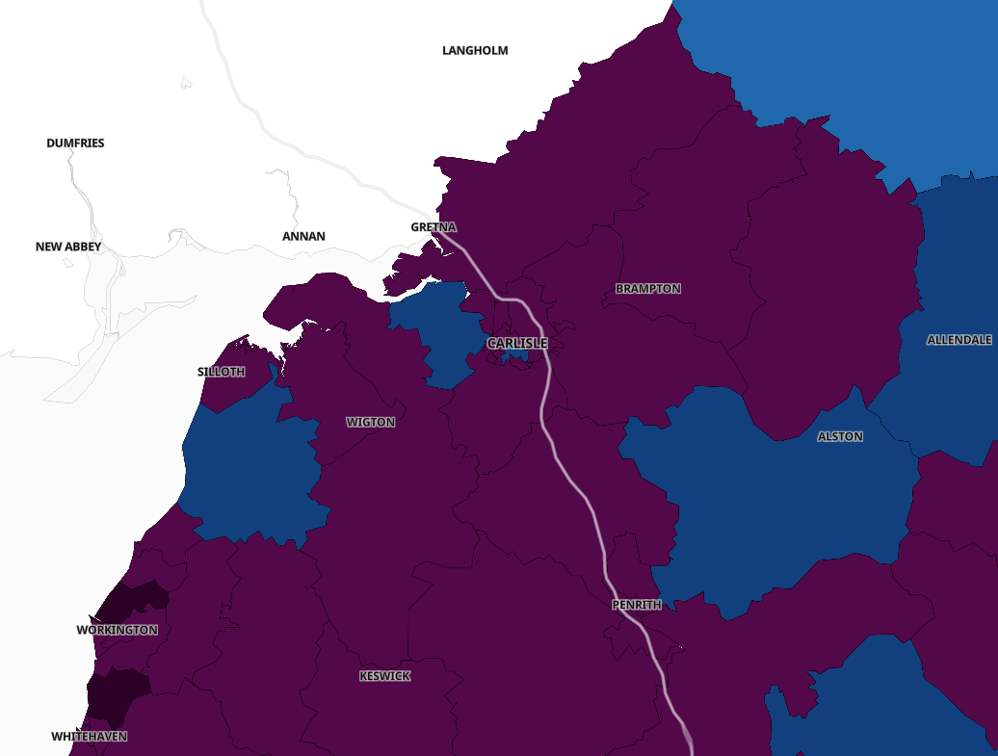
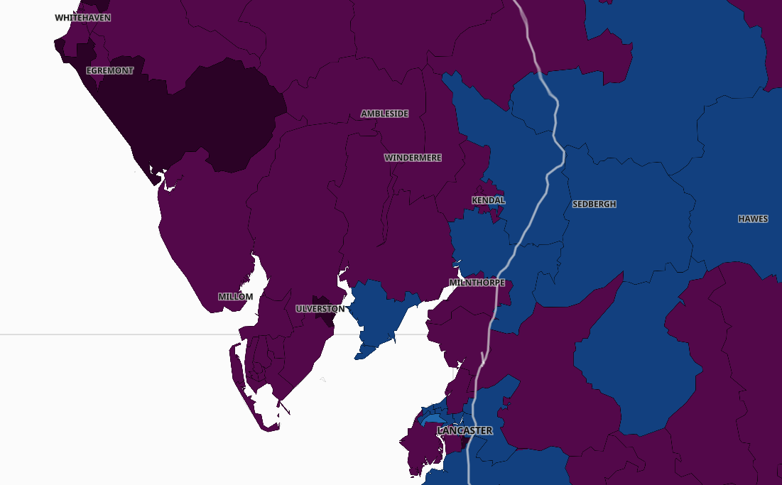
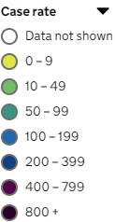
Cases by Middle Super Output Area (MSOA)
Case rate per 100,000 people for 7–day period ending on 14 October 2021:
https://coronavirus.data.gov.uk/details/interactive-map
Last updated on Tuesday 19 October 2021 at 4:00pm

Slide 8
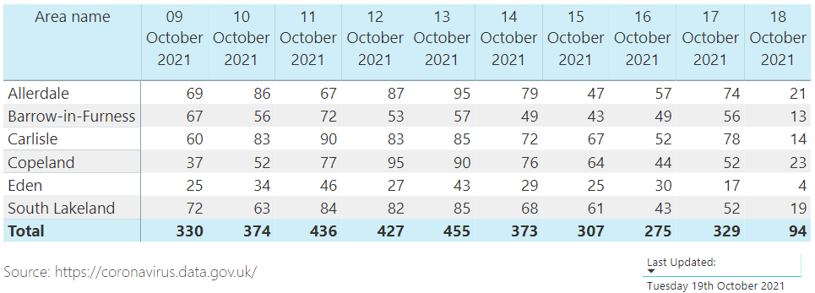
District cases – latest data
[Preliminary up to 18th October 2021]
[Data is subject to revisions; most recent days are provisional and likely to increase as lab results are processed]

Slide 9
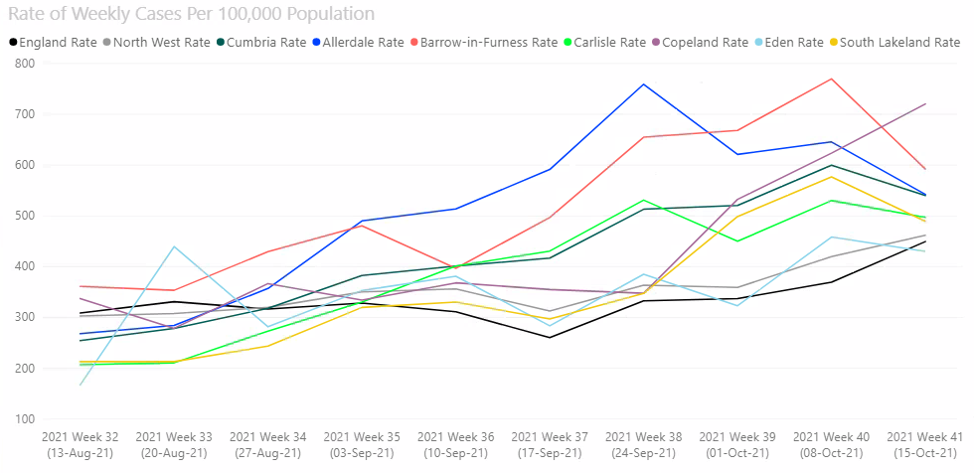
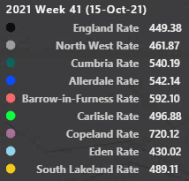
Rate of Cases Per 100,000 Population
Key Points for Cumbria and districts in 2021 Week 41 (Ending Friday 15th October):
Copeland overtook Barrow-in-Furness in having the highest rate of new cases (720 new cases per 100k population);
Rates in all Cumbrian districts, except Eden, were above the regional and national averages (North West 462 and England 449 new cases per 100k population).
Source: https://coronavirus.data.gov.uk
Data represents the number of people with a positive test result per 100k population.

Slide 10
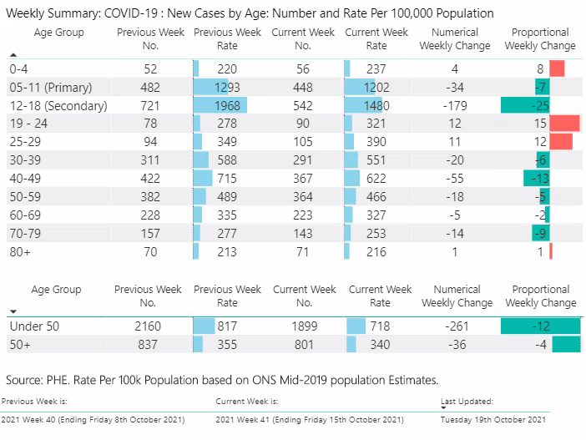
Cases by Age Group
Key Points for Cumbria in 2021 Week 41 (Ending Friday 15th October):
The 12-18 age group accounted for the greatest number of new cases in Cumbria followed by the 5-11 age group (+542 and +448 new cases respectively);
The 12-18 and 5-11 age groups also accounted for by far the greatest rates of new cases in Cumbria (1,480 and 1,202 new cases per 100k population respectively);
However, new cases decreased from the previous week in the 12-18 and 5-11 age groups (-25% and -7% respectively);
New cases also decreased from the previous week in all other age groups except the 0-4, 19-24, 25-29 and 80+ age groups;
The 19-24 age group experienced the greatest numerical and proportional increase (an increase of 12, +15%, from the previous week);
New cases in the under 50 age group accounted for 70% of total new cases (compared to 72% in the previous week);
The rate of new cases in the under 50 age group was 2.1 times higher than the rate of new cases in the 50+ age group (compared to 2.3 times higher in the previous week);
Overall, new cases in the under 50 age group decreased by 12% compared to a 4% decrease in the 50+ age group.

Slide 11
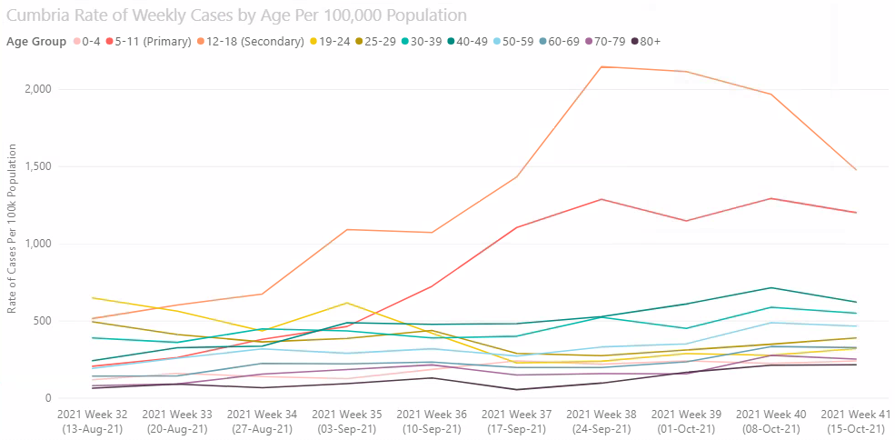
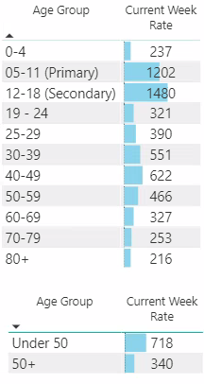
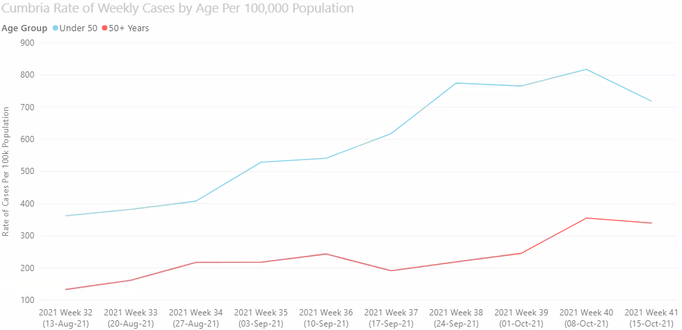

Cases by Age Group – Rate per 100,000

Slide 12

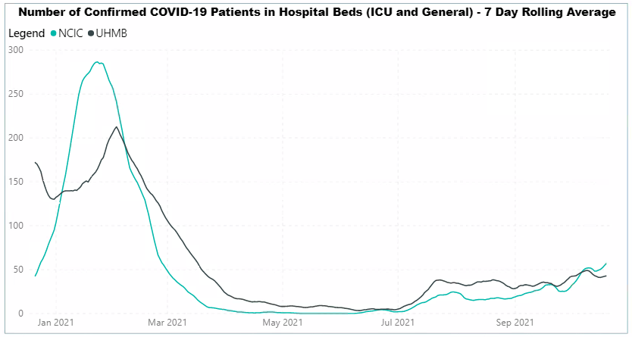
Hospitalisations
Summary for week ending Tuesday 19th October:
The number of new patients admitted with COVID-19 Positive status in North Cumbria Integrated Care (NCIC) increased by 16 from the previous week;
Furthermore, the number of new patients admitted with COVID-19 Positive status in University Hospitals of Morecambe Bay NHS Foundation Trust (UHMB) increased by 10 from the previous week;
The average number of patients with COVID-19 in beds in NCIC increased by 6 from the previous week;
However, the average number of patients with COVID-19 in beds in UHMB decreased by 2 from the previous week.
Source: NHS Daily Sit Rep Submissions. Please be aware that the data is collected as a ‘sitrep’ on the day and is not refined retrospective reporting data. It is susceptible to error caused by delays in data entry and as simple admin errors. There is no mechanism for updating or correcting any such occurrences with NHSE/i - the prime recipient.

Slide 13
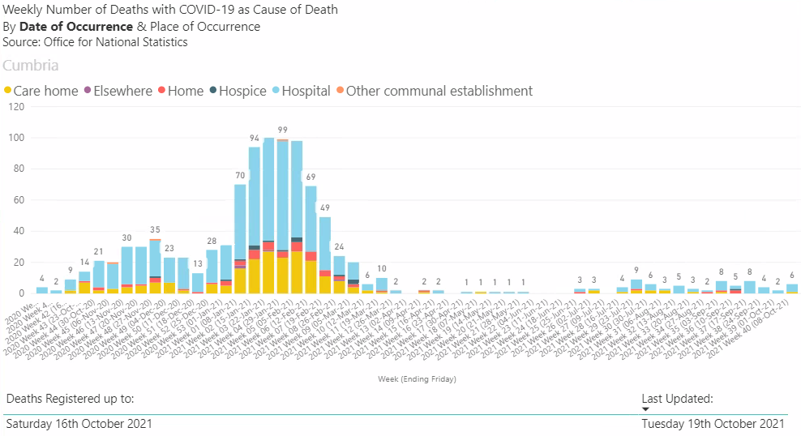

Slide 14
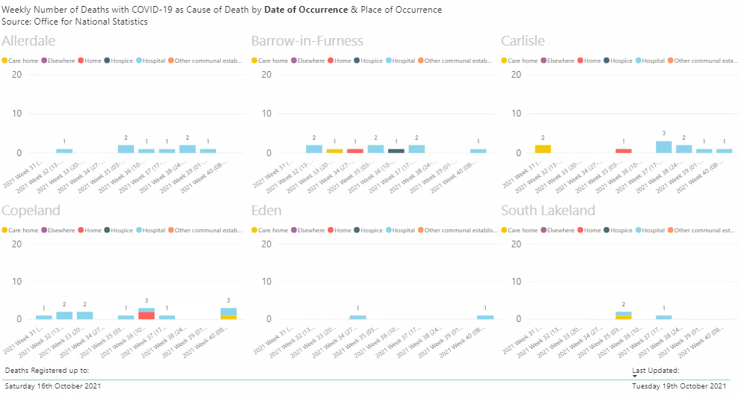

Slide 15
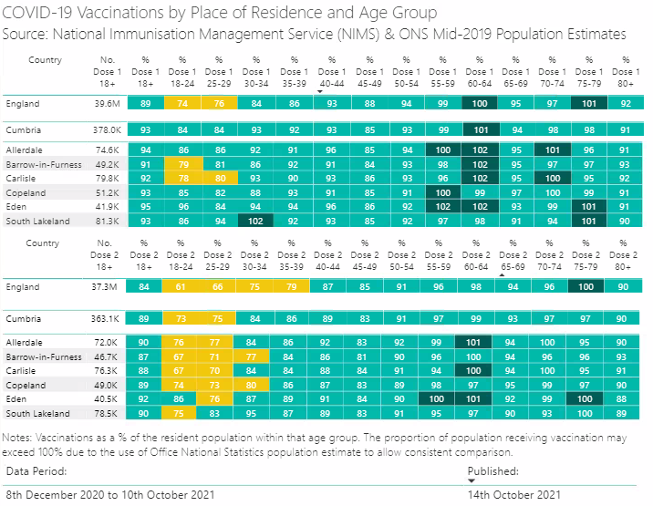
Vaccinations – Proportion of Population by Dose

Slide 16
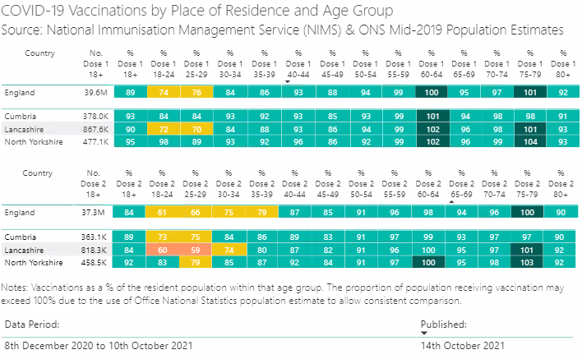
Vaccination – Proportion by Dose
Cumbria comparison to Local Authorities with similar statistical profiles

Slide 17
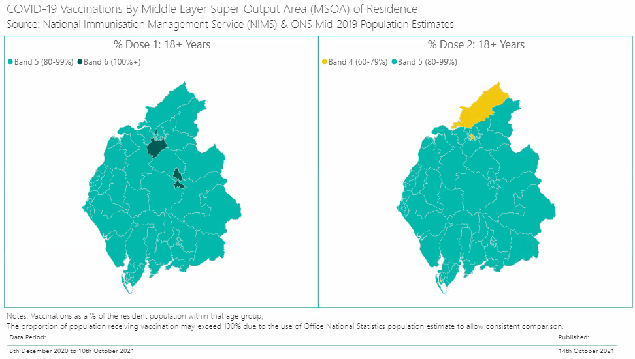
Vaccinations – Proportion by Dose
Cumbria MSOA level mapped

